Slide 1




COMPOSITE
CONSTRUCTION
INPRE-ENGINEERED BUILDINGS
Dr. Padmaja Gokaraju
Asst. Vice President –Designs
M/s KIRBY BUILDING SYSTEMS
& STRUCTURES (I) PVT LTD
NATIONAL WORKSHOP ON PREFRABRICATED BUILDINGS AND CONSTRUCTION
29th & 30th NOVEMBER 2021

Slide 2
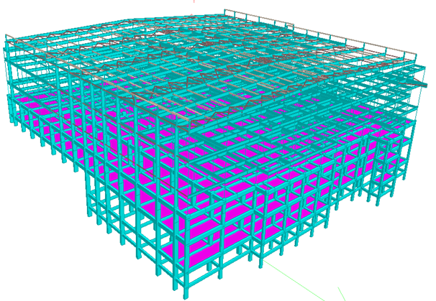
CONTENTS
INTRODUCTION
ABOUT PEB
ABOUT COMPOSITE CONSTRUCTION
STEEL CONCRETE COMPOSITE SLABS
COMPOSITE CONCRETE FILLED STEEL TUBE COLUMNS
COMPOSITE HIGH-DENSITY POLYURETHANE FOAM FILLED ALUMINIUM AND LIGHT GAUGE STEEL TUBES
CONCLUSIONS
NATIONAL WORKSHOP ON PREFRABRICATED BUILDINGS AND CONSTRUCTION
29th & 30th NOVEMBER 2021

Slide 3

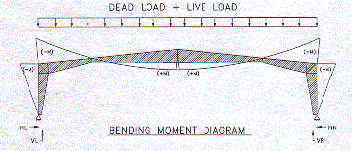
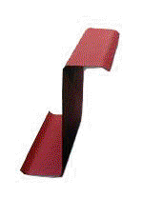

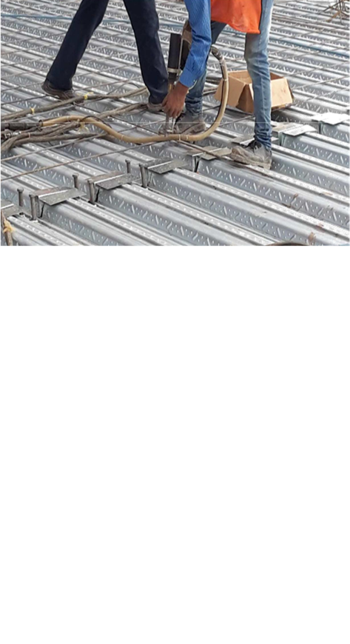
TOPIC ONE
In past 3 decades, there has been a huge development in construction of steel structures related to design concepts, materials, section profiles, manufacture, and erection methods, code provisions, etc.
Evolution of Pre-Engineered Buildings (PEB) is one such revolution, which has gained importance and mostly replaced the conventional steel buildings for many applications.
In recent developments, the concept of PEB is extended to heavy industrial structures and high-rise buildings where mezzanine floors with heavy loads, large and unequal column spacings is required.
Potential for composite construction is increased and it can be adopted in two major elements, floor beams and columns in PEB.
Further developments on composite filled aluminium/LGS tubes with lighter infill materials like polyurethane foam showed interesting results that are suitable for modular buildings.
SUBTITLE
NATIONAL WORKSHOP ON PREFRABRICATED BUILDINGS AND CONSTRUCTION
29th & 30th NOVEMBER 2021

Slide 4
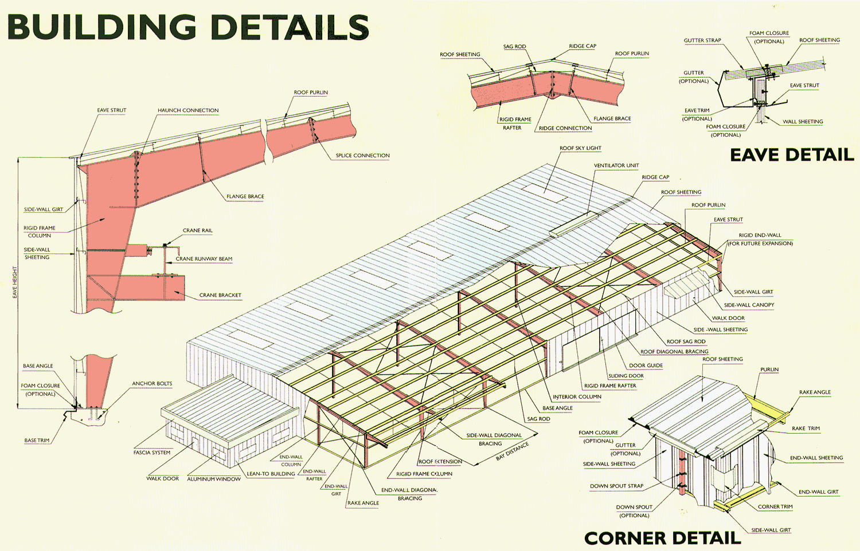
About PEB
PEB uses systems approach by combining elements such as roof panels, wall panels, purlins, girts, main frames, wind bracings etc to act integrally, also rely on standard designs with standard configurations, with each component uniquely profiled to suit design requirements.
By using sophisticated manufacturing facilities and engineering software, the PEBs are custom designed to meet the specific customer needs.
PEBs are always manufactured in factories and shipped to job sites for assembly assuring a 100% quality structure from single source of supply with on time deliveries.
NATIONAL WORKSHOP ON PREFRABRICATED BUILDINGS AND CONSTRUCTION
29th & 30th NOVEMBER 2021

Slide 5
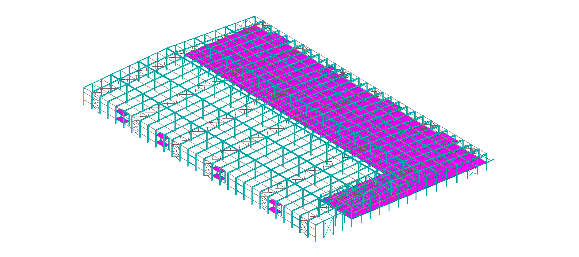
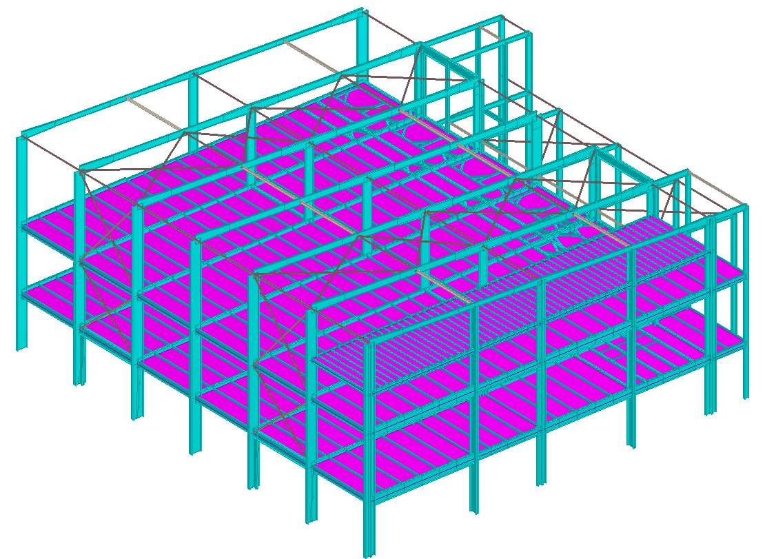
TOPIC ONE
About PEB
EXTENDED APPLICATIONS OF PEB
Warehouse Building for AMAZON 40,000sqm
Process Building for ALPLA
SUBTITLE
NATIONAL WORKSHOP ON PREFRABRICATED BUILDINGS AND CONSTRUCTION
29th & 30th NOVEMBER 2021

Slide 6
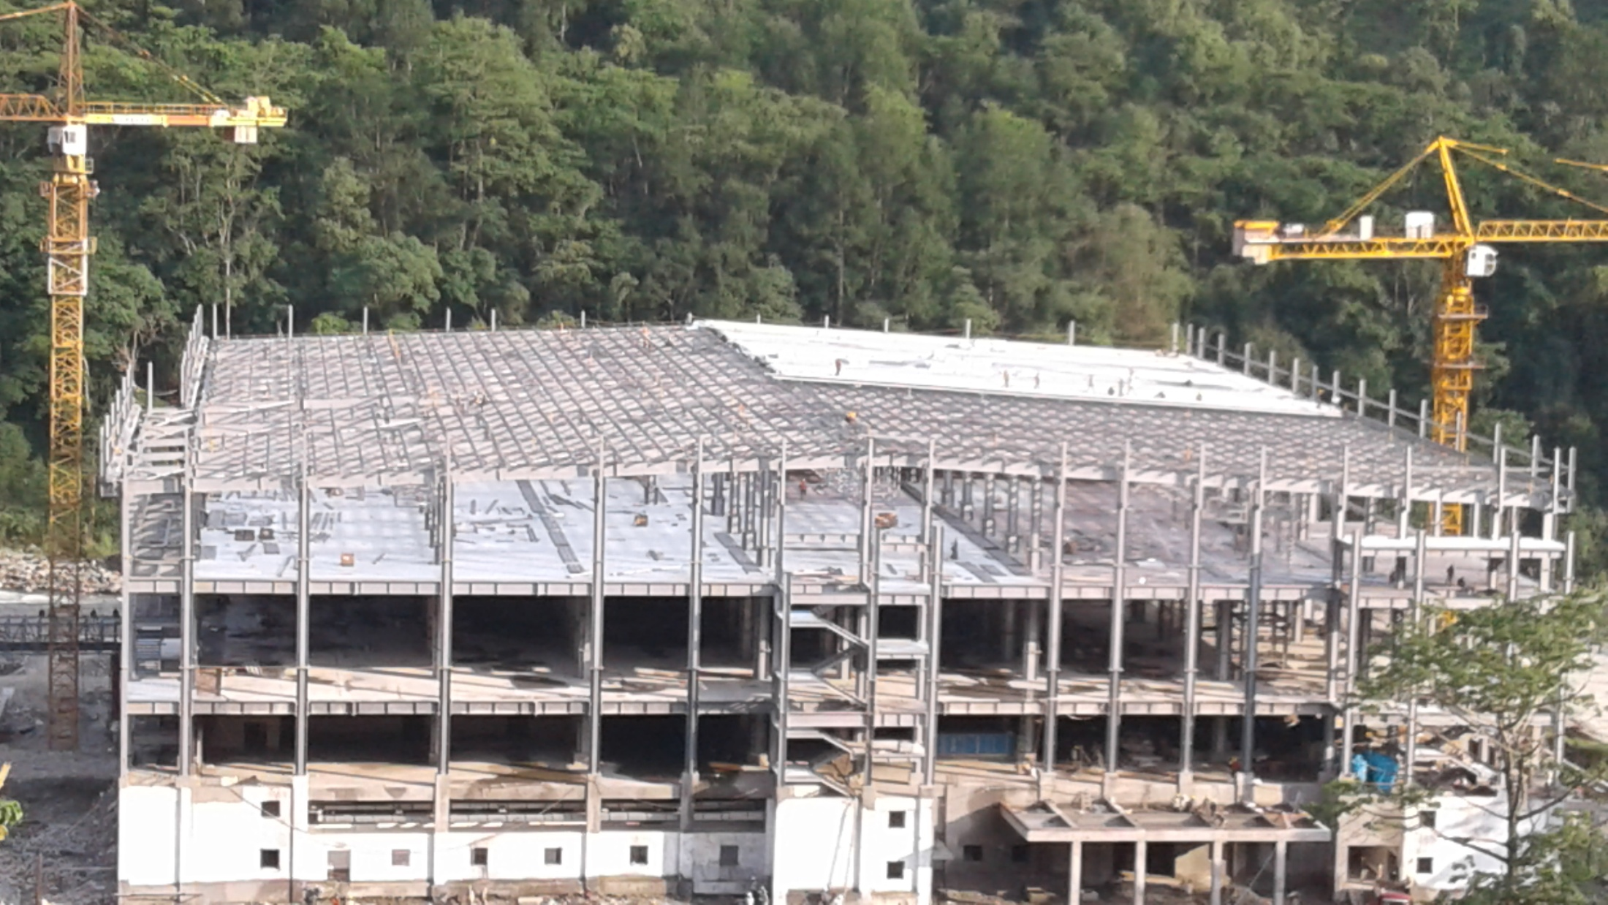
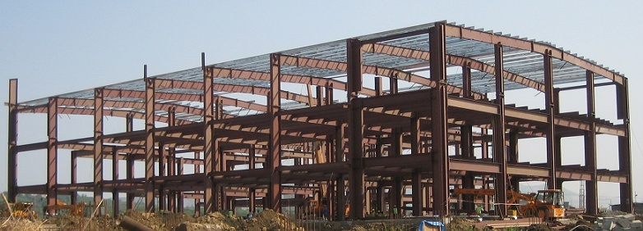
TOPIC ONE
About PEB
EXTENDED APPLICATIONS OF PEB
CIPLA PHARMA INDUSTRY
RELIENCE OFFICE BUILDING
SUBTITLE
NATIONAL WORKSHOP ON PREFRABRICATED BUILDINGS AND CONSTRUCTION
29th & 30th NOVEMBER 2021

Slide 7
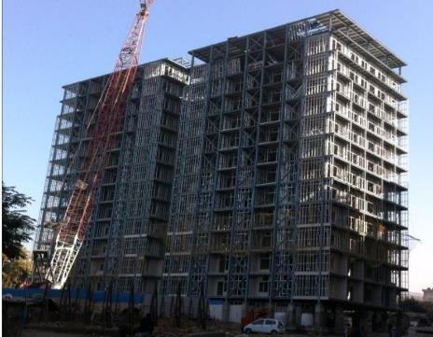
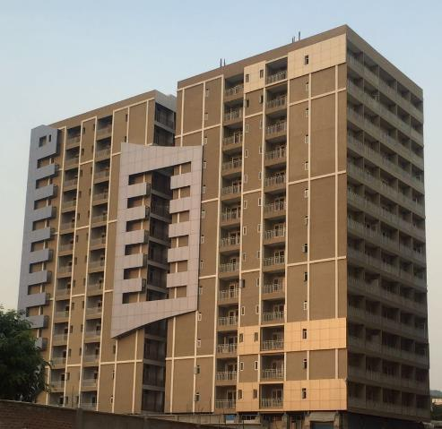
TOPIC ONE
About PEB
EXTENDED APPLICATIONS OF PEB
MGI Infra Nipani, Jammu
G+13 Residential Building - 6,060 sqm
SUBTITLE
NATIONAL WORKSHOP ON PREFRABRICATED BUILDINGS AND CONSTRUCTION
29th & 30th NOVEMBER 2021

Slide 8
TOPIC ONE
About PEB
EXTENDED APPLICATIONS OF PEB
CtrlS Data Center, Navi Mumbai (G+12 Data Center Bldg)
Vellapally Brothers, Kerala (G+17 Commercial Building)
SUBTITLE
NATIONAL WORKSHOP ON PREFRABRICATED BUILDINGS AND CONSTRUCTION
29th & 30th NOVEMBER 2021

Slide 9
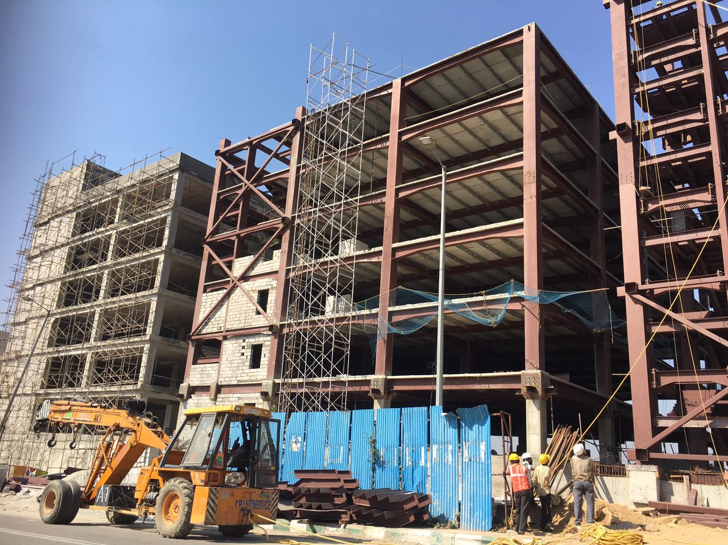
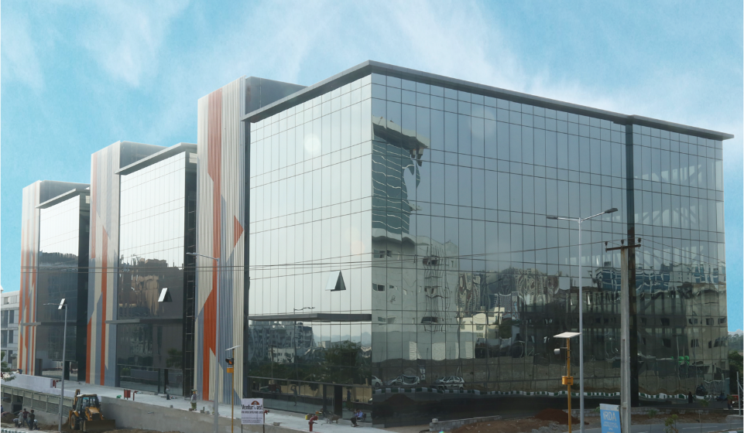
TOPIC ONE
About PEB
EXTENDED APPLICATIONS OF PEB
Phoenix Spaces, Hyderabad, India (Commercial Building)
SUBTITLE
NATIONAL WORKSHOP ON PREFRABRICATED BUILDINGS AND CONSTRUCTION
29th & 30th NOVEMBER 2021

Slide 10
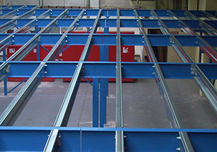
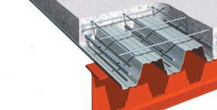
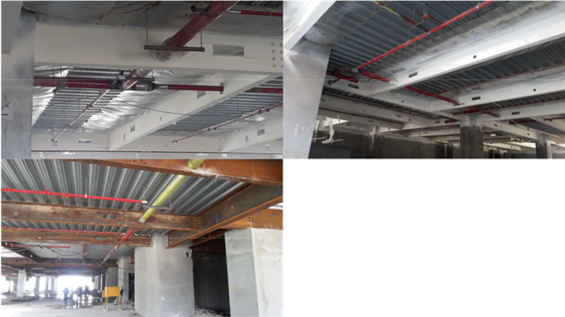
TOPIC ONE
STEEL MEZZANINE FLOORS
WITH PROFILED METAL DECK SHEET
Acts as permanent shuttering
Evenly transfers the forces to the beams below.
Imparts diaphragm action & rigidity in longitudinal direction.
More clear space below mezzanine floor.
Simultaneous RCC slab casting above the floor and providing service lines below saves time.
SUBTITLE
NATIONAL WORKSHOP ON PREFRABRICATED BUILDINGS AND CONSTRUCTION
29th & 30th NOVEMBER 2021

Slide 11
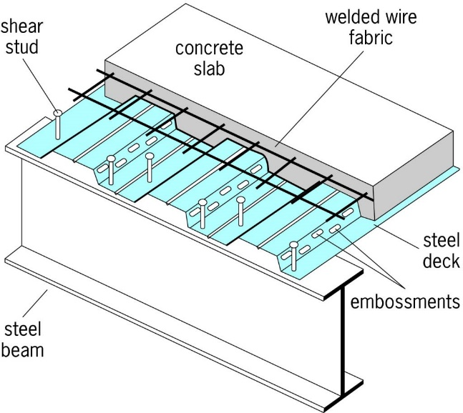
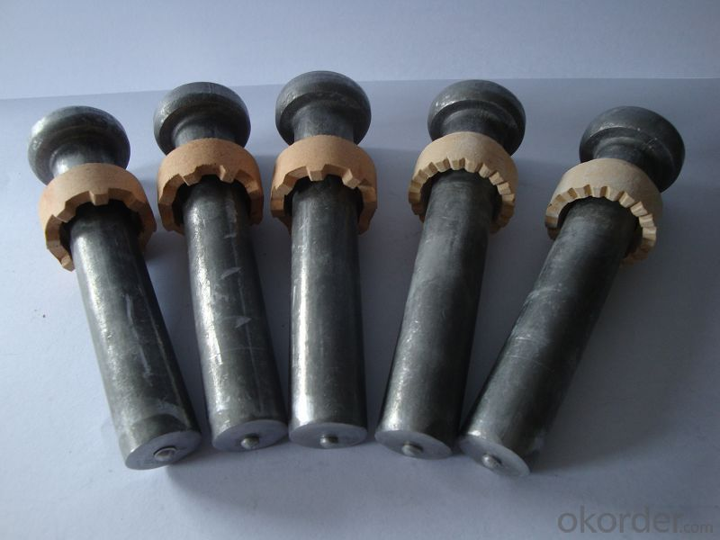
TOPIC ONE
STEEL CONCRETE COMPOSITE FLOORS
Shear connectors are welded to the steel beams through metal deck sheets.
Concrete is assumed to take total compression while the steel takes all the tension.
Shear connectors are provided to transfer the horizontal shear force across the interface, prevent vertical separation and slip between them.
Steel beam and concrete slab act as a composite beam.
Composite floor induces diaphragm action, adding stability to the overall structure, resisting severe seismic forces in both mutual directions and provides an economical solution.
SUBTITLE
Ceramic ferrule shear connectors
NATIONAL WORKSHOP ON PREFRABRICATED BUILDINGS AND CONSTRUCTION
29th & 30th NOVEMBER 2021

Slide 12
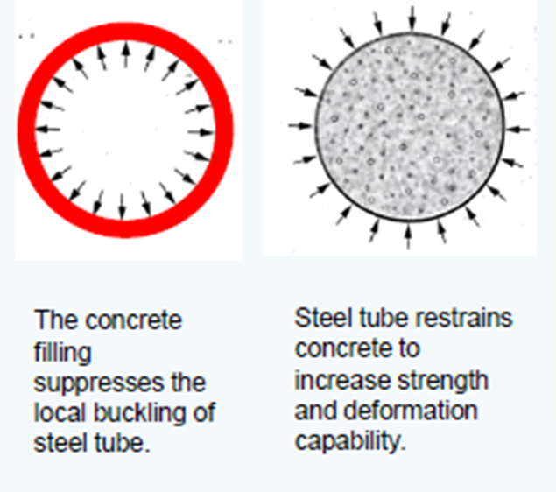
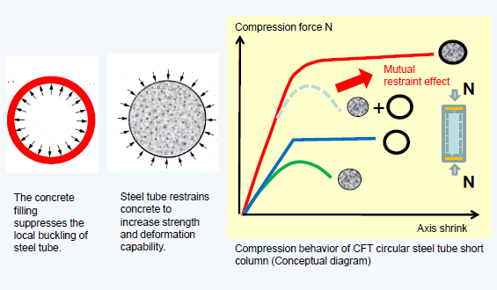
TOPIC ONE
COMPOSITE CONCRETE FILLED STEEL TUBES
Concrete filled steel tubes (CFT) uses the advantage of both steel and concrete.
Infill concrete in steel tube delays local buckling Steel tube reinforces the concrete to resist tensile forces.
This result into triaxial state of compression in the core and pure hoop tension in the envelope which increases the overall strength and ductility of section.
Strength of the concrete filled steel tubular columns against direct compression and combined bending and compression is assessed using the international codes CIDECT, ANSI/AISC360-16, AIJ, JSCE, EC4, IS 11384 etc.
CFST -Behaviour
of Infill on Envelop
SUBTITLE
CFST -Behaviour of Envelop on Infill
NATIONAL WORKSHOP ON PREFRABRICATED BUILDINGS AND CONSTRUCTION
29th & 30th NOVEMBER 2021

Slide 13
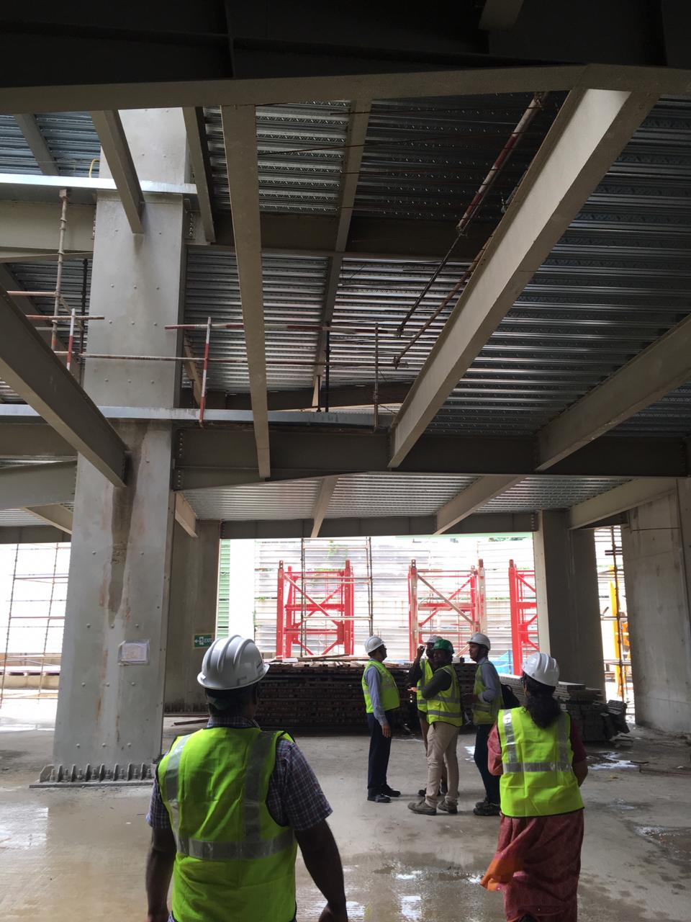
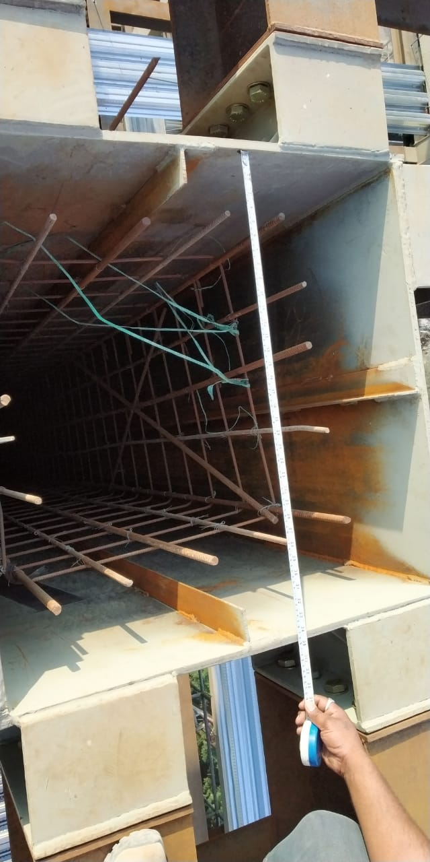
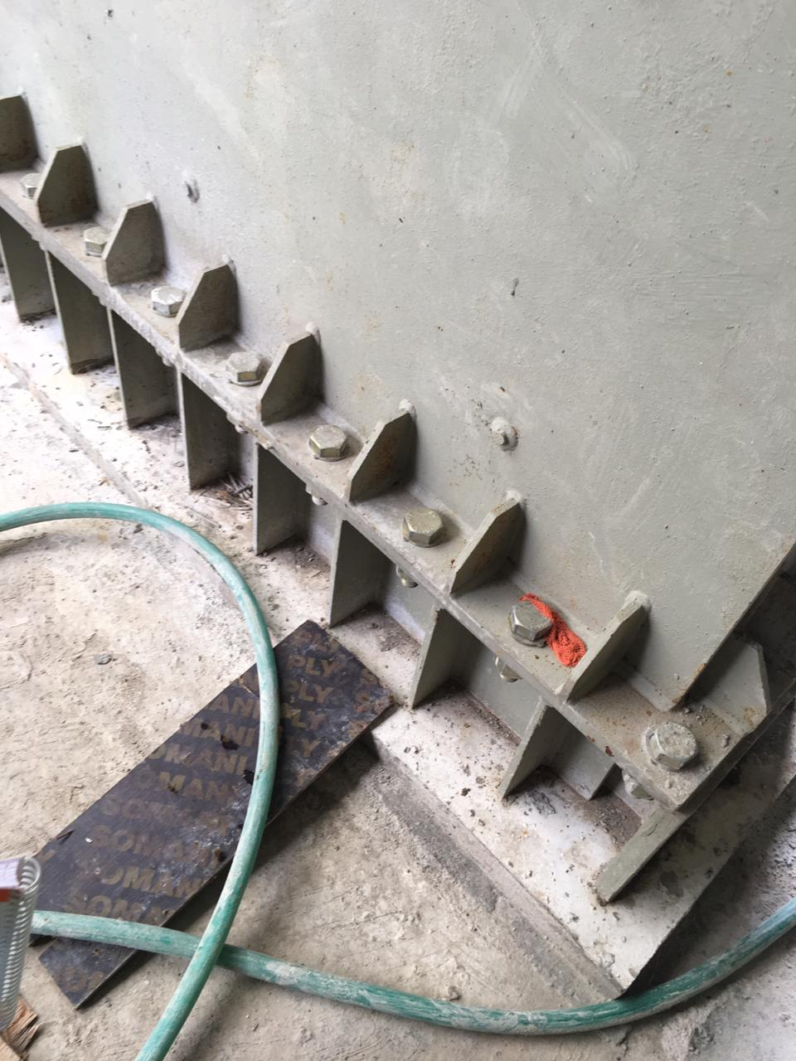
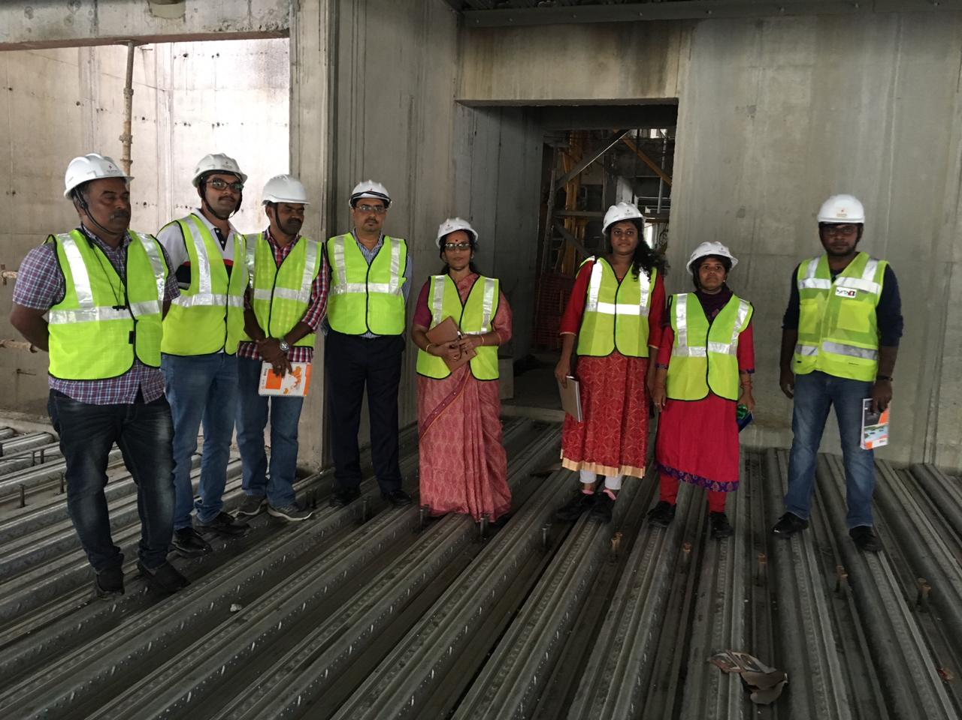
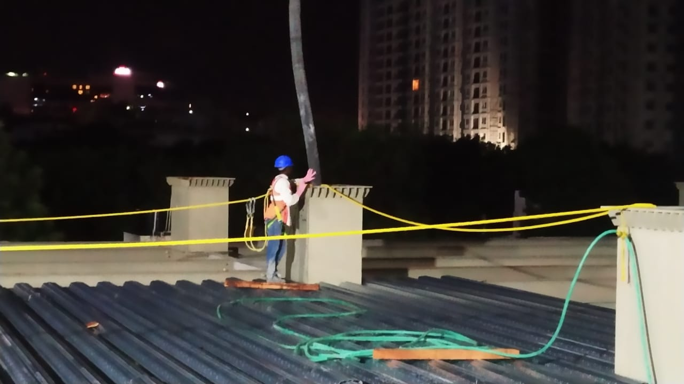
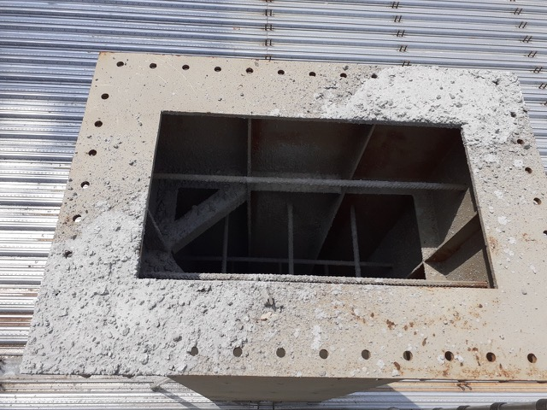
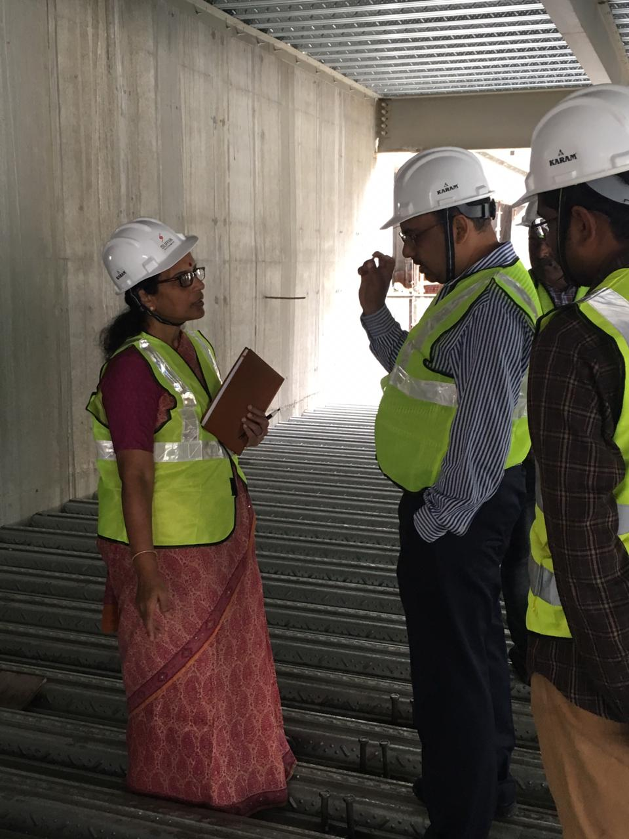
TOPIC ONE
COMPOSITE CONCRETE FILLED STEEL TUBES - CONSTRUCTION
SUBTITLE
NATIONAL WORKSHOP ON PREFRABRICATED BUILDINGS AND CONSTRUCTION
29th & 30th NOVEMBER 2021

Slide 14
Composite High-Density Polyurethane Foam Filled
Aluminium and Light Gauge Steel Tubes
Aluminium and GI LG Steel have light weight, high strength–to-weight ratio, anti-corrosive, recyclable, and high ductile characteristics, proved as good choice for tube envelop materials.
Polyurethane foam is proved to have merits like higher quality, higher strength-to-weight ratio, and improved bond characteristics with envelop and without micro cracking problems.
Experimental investigation on empty and composite high-density (150kg/m3) PU foam filled circular aluminium (D/t of 30.15, 40.20) and square steel tubes (B/t of 83.33, 100,125) is carried out. Improved performance of composite high-density PU foam filled tubes is assessed in axial compression and bending.
NATIONAL WORKSHOP ON PREFRABRICATED BUILDINGS AND CONSTRUCTION
29th & 30th NOVEMBER 2021

Slide 15
Composite High-Density Polyurethane Foam Filled
Aluminium and Light Gauge Steel Tubes
Study on bond strength between foam and tube wall is also done. An attempt is made to understand their behaviour in tension and torsion. The results are validated through numerical investigation using ABAQUS software.
They are also compared with analytical models proposed by codes and relevant past research, wherever applicable. This study revealed that foam filling in tube can enhance the overall strength and behaviour of aluminium and steel tubes, and the interaction between tube wall and foam provides composite behaviour to the filled tube, with requisite bond at the interface.
NATIONAL WORKSHOP ON PREFRABRICATED BUILDINGS AND CONSTRUCTION
29th & 30th NOVEMBER 2021

Slide 16
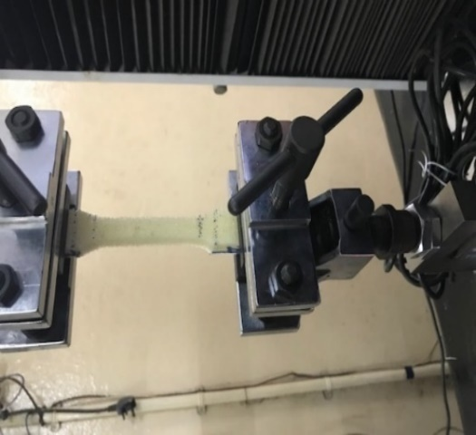
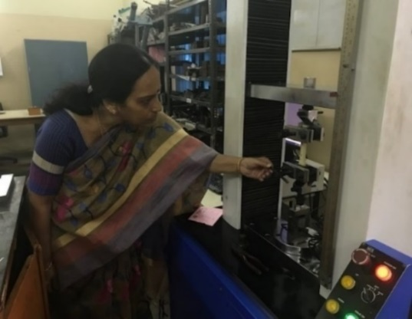
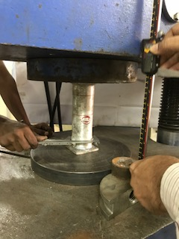
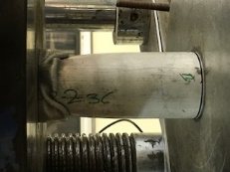
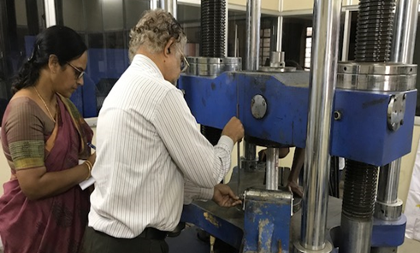
EXPERIMENTAL INVESTIGATION
Tensile Coupon test on PU Foam using Digital UTM, MCS-25 kN capacity at 250C as per ASTM A370-2016.
Quasi Static Axial compression tests on Empty & PUFF Aluminium Tubes according to ASTM E8-08 and ASTM D3574-03
NATIONAL WORKSHOP ON PREFRABRICATED BUILDINGS AND CONSTRUCTION
29th & 30th NOVEMBER 2021

Slide 17
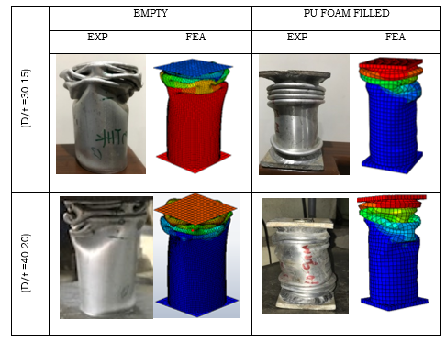
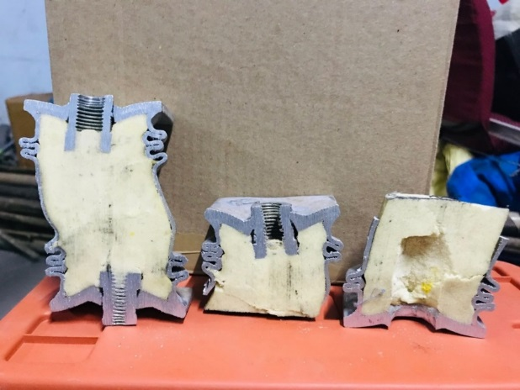
ANALYSIS OF RESULTS
MODE SHAPES: Circular Aluminium Tubes
EXP
FEM
          (ii)
          Mode Shapes of Empty Vs PU Foam Filled C Al Tubes.(ii) Cut Specimen
          Puff past study-concertina mode
          The increased number of folds indicate the increased plastic strength of PUFF tube and improves the energy absorption capacity. The present results are in agreement with past research.
NATIONAL WORKSHOP ON PREFRABRICATED BUILDINGS AND CONSTRUCTION
29th & 30th NOVEMBER 2021

Slide 18
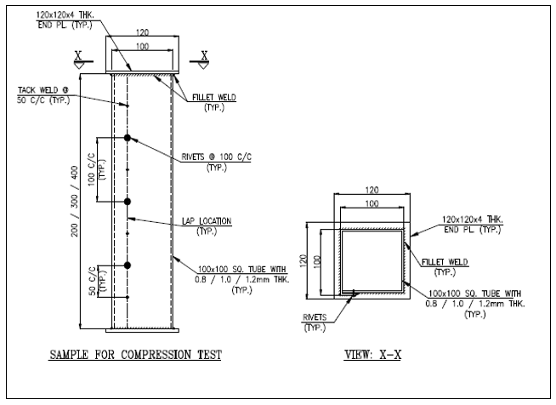
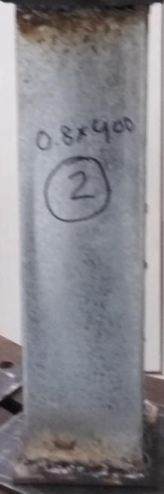
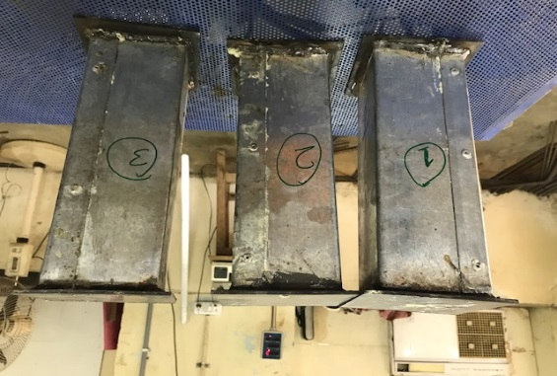
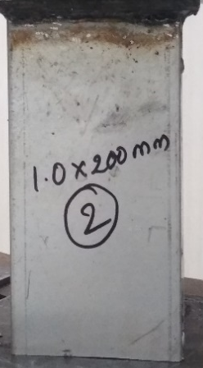
EXPERIMENTAL INVESTIGATION
EMPTY & PU FOAM FILLED LGSQUARE STEEL TUBES: QUASI STATIC AXIAL COMPRESSION.
200mm long 300mm long 400mm long
Sketch showing details of Square Steel Tube samples
Square Steel Tube samples for axial compression test
NATIONAL WORKSHOP ON PREFRABRICATED BUILDINGS AND CONSTRUCTION
29th & 30th NOVEMBER 2021

Slide 19
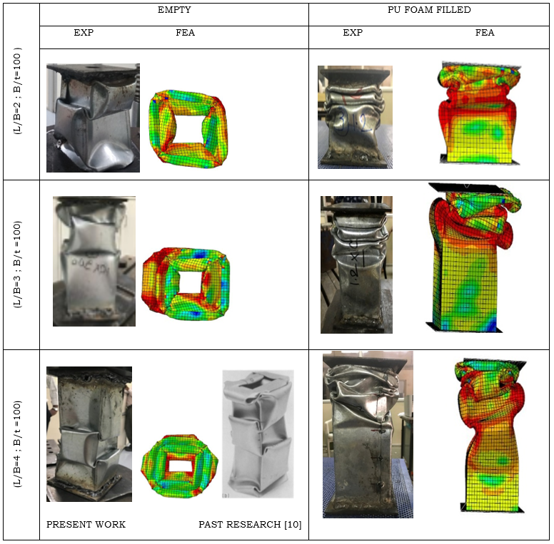
ANALYSIS OF RESULTS
EMPTY & PU FOAM FILLED LGSQUARE STEEL TUBES: QUASI STATIC AXIAL COMPRESSION.
Failure Modes of Empty and EXP Vs FEM of PU FF Square Steel Tubes
The Failure Modes are in agreement. More energy absorption capacity observed.
NATIONAL WORKSHOP ON PREFRABRICATED BUILDINGS AND CONSTRUCTION
29th & 30th NOVEMBER 2021

Slide 20
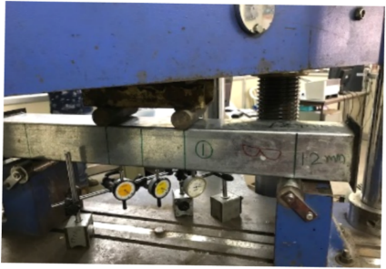
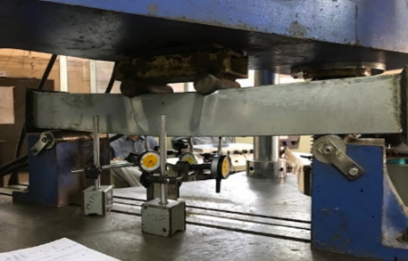
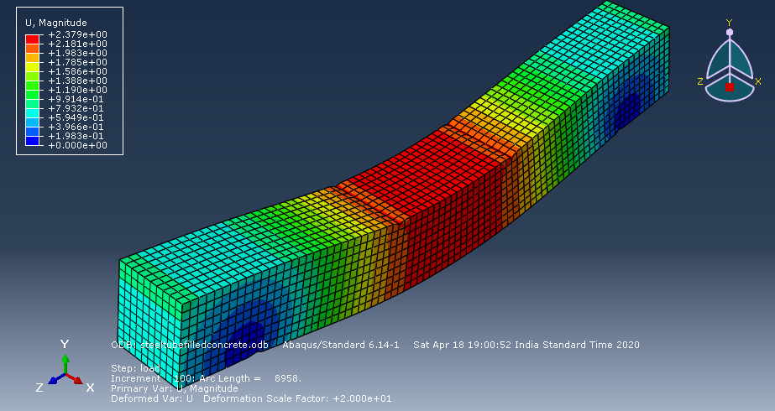
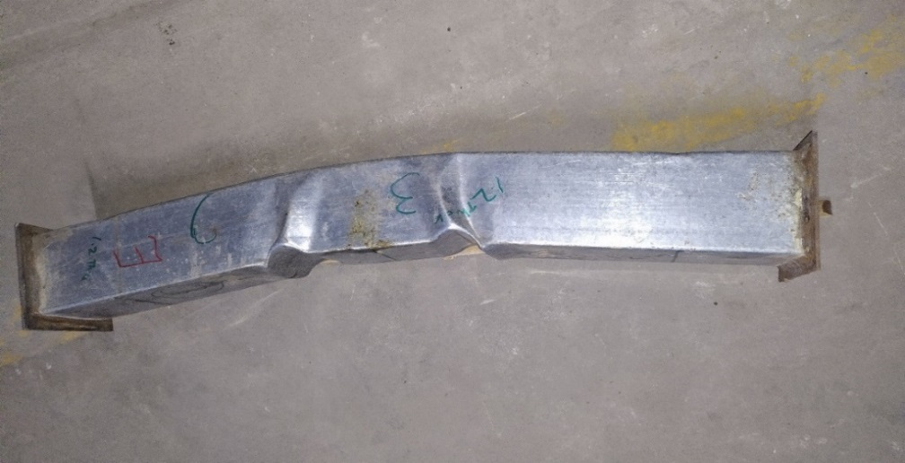
EXPERIMENTAL, NUMERICAL INVESTIGATION
PUFF SQUARE STEEL TUBES: FOUR-POINT BENDING TEST.
PU FF Square Steel Beam –Experimental setup-Four Point Bending Test
PU FF Square Steel Beam –Shear Bending below load and Pure bending between load points
FEM -Deformed shape of M14 CFTube -Four Point Bending Test-
NATIONAL WORKSHOP ON PREFRABRICATED BUILDINGS AND CONSTRUCTION
29th & 30th NOVEMBER 2021

Slide 21
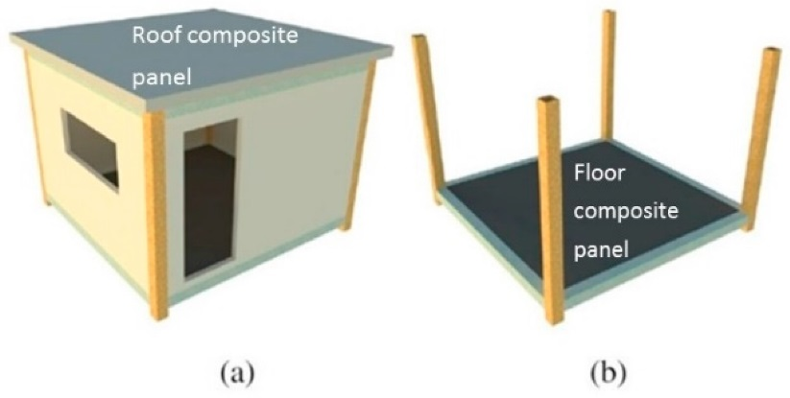
APPLICATIONS OF COMPOSITE HIGH-DENSITY
PU FOAM FILLED ALUMINIUM /LG STEEL TUBES
The resultant Product will find various applications in many fields like
Modular Buildings
Bridge Truss members
Transmission Line Tower members
Automobile
Structural members in High – Rise buildings
Structural members for Solar applications
Highway Crash Barriers.
Light weight shelters.
Wherever weight reduction without compromising the strength is applicable.
Wherever transportability and maintenance for corrosion is an issue, these members can be easily adopted.
NATIONAL WORKSHOP ON PREFRABRICATED BUILDINGS AND CONSTRUCTION
29th & 30th NOVEMBER 2021

Slide 22
CONCLUSIONS
Composite Construction is an economical solution for multi floor Pre-Engineered Buildings
More research and development is required to assess their behaviour.
More user friendly software are required to analyse and design the composite floors and columns.
Institutions and industries should work together to get the updated Indian Codes and guide lines for composite construction.
NATIONAL WORKSHOP ON PREFRABRICATED BUILDINGS AND CONSTRUCTION
29th & 30th NOVEMBER 2021

Slide 23
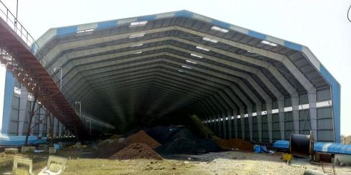
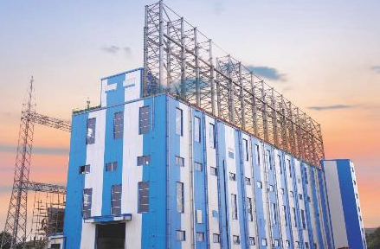
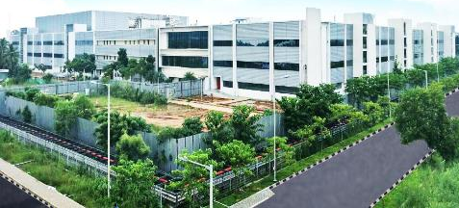
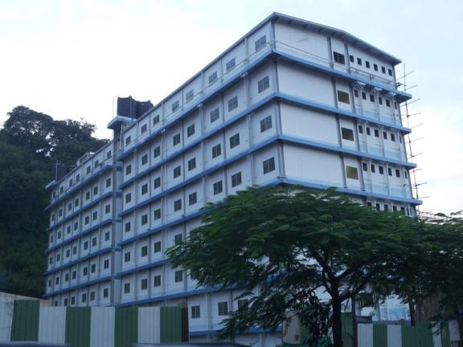
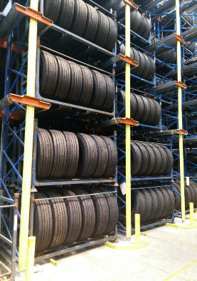
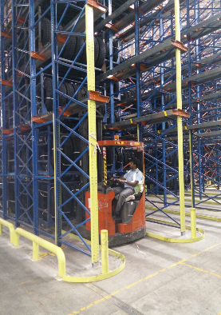


THANK YOU
Dr. Padmaja Gokaraju
Asst. Vice President –Designs
KIRBY BUILDING SYSTEMS & STRUCTURES (I) PVT LTD
NATIONAL WORKSHOP ON PREFRABRICATED BUILDINGS AND CONSTRUCTION
29th & 30th NOVEMBER 2021

